Slide 1
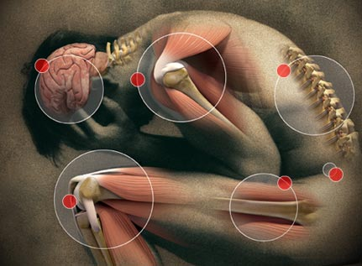
Chronic Pain
Bhagya Gunetilleke
Consultant Anaesthetist
Senior Lecturer in Anaesthesia
Department of Surgery

Slide 2
Pain - Definition
Unpleasant
Sensory & emotional experience
Associated with actual or potential tissue damage or described in terms of such
IASP- Merskey
Chronic pain – Lasting more than 3 months/ after wound is healed

Slide 3
More Definitions
Allodynia – Pain / harmless stimulus
Hyperaesthesia – Increased pain / painful stimulus
Hyperalgesia – Increased pain / suprathreshold stimulus

Slide 4
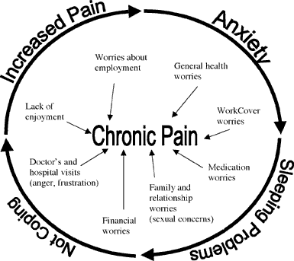
Chronic Pain
Multifactorial aetiology
Nerve damage
Depression
Poor sleep
Immobility
Nutritional status
Co-morbidity – eg cancer, DM
Potential benefits

Slide 5
Complex Regional Pain Syndrome (CRPS)
Burning pain, hyperaesthesia, vasomotor & dystrophic changes
Eg. Oedema, hyper/hypothermia, abnormal hair & nail growth
Associated emotional upset
Type I – No obvious precipitating injury
Type II – Preceding injury eg. Sprains, fractures

Slide 6
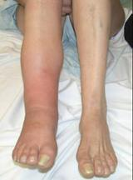
Complex Regional Pain Syndrome (CRPS)

Slide 7
Neurogenic Pain
Caused by central or peripheral nerve damage
Eg. Post herpetic neuralgia – cell loss in dorsal root ganglion
Pain persists after rash has healed
Commonly V1, T5 & T6 dermatomes
Rx. Acyclovir, sympathetic block, amitryptiline

Slide 8
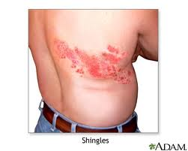
Post Herpetic Neuralgia

Slide 9
Myofascial Pain – ‘Trigger Point’ Pain
Trauma/ stress to intramuscular connectinve tissue
Acute ------> Chronic
Mechanical/ emotional stress,

Slide 10
Trigeminal Neuralgia
Bursts of severe, lancinating pain triggered by touch
Usually unilateral & in one division of trigeminal N
Underlying causes- DM, multiple sclerosis, SOL
Rx. Carbamazepine, Gabapentin, surgical decompression

Slide 11
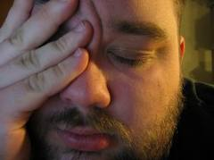
Trigeminal Neuralgia

Slide 12
Cancer Pain
In a majority of patients with cancer
‘Whole body pain’, neurogenic, depression, malnutrition
Believe the patient, Empathy
Analgesic ladder, by the mouth, by the clock
Additional – Radio/ chemotherapy, Local blocks, Ketamine

Slide 13
Phantom Limb Complex
Limb sensation
Stump pain
Limb pain – pain referred to absent limb
Predisposing factors
Pre amputation pain
Stress, spinal anaesthesia, stump pressure

Slide 14
Phantom Limb Complex
Prevention- Difficult to predict occurrence
Effective analgesia – eg Pre- amputation
epidural continued intra/ post op
Good surgical technique
Treatment
Medical – Tricyclic antidepressants, opioids,
Ketamine, oral lignocaine
Non-medical – TENS, acupuncture, hypnosis

Slide 15
Management
Assessment –
Site Relief
Sort Aggravation
Severity Disability
Onset Litigation
Periodicity
Duration

Slide 16
Management
Assessment tools
Short-form McGill Questionnaire
HADS – Hospital Anxiety and Depression Scale

Slide 17
Management
Treatment
Analgescis – WHO pain ladder (picture)
Adjuvants – TCAs eg amitryptilline
Local anaesthesia –
Epidural
Blocks –
Sympathetic – Stellate, coeliac,
lumbar sympathetic,
Psychological support

Slide 18
Summary
Chronic pain affects 60-70% of adult population
Multi-factorial origin
Assessment - vital
Multi-pronged treatment plan
Response to treatment variable

